Slide 1
THIS IS YOUR PRESENTATION TITLE

Slide 2
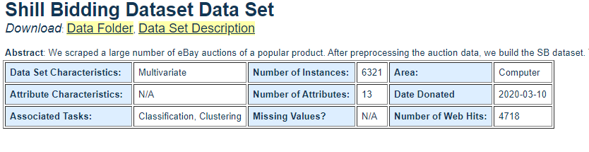
Dataset
Link Dataset
archive.ics.uci.edu/ml/datasets/Shill+Bidding+Dataset

Slide 3
Informasi Dataset
Attribute Information:
Record ID: Unique identifier of a record in the dataset. Auction ID: Unique identifier of an auction. Bidder ID: Unique identifier of a bidder. Bidder Tendency: A shill bidder participates exclusively in auctions of few sellers rather than a diversified lot. This is a collusive act involving the fraudulent seller and an accomplice. Bidding Ratio: A shill bidder participates more frequently to raise the auction price and attract higher bids from legitimate participants. Successive Outbidding: A shill bidder successively outbids himself even though he is the current winner to increase the price gradually with small consecutive increments. Last Bidding: A shill bidder becomes inactive at the last stage of the auction (more than 90\% of the auction duration) to avoid winning the auction. Auction Bids: Auctions with SB activities tend to have a much higher number of bids than the average of bids in concurrent auctions. Auction Starting Price: a shill bidder usually offers a small starting price to attract legitimate bidders into the auction. Early Bidding: A shill bidder tends to bid pretty early in the auction (less than 25\% of the auction duration) to get the attention of auction users. Winning Ratio: A shill bidder competes in many auctions but hardly wins any auctions. Auction Duration: How long an auction lasted. Class: 0 for normal behaviour bidding; 1 for otherwise.

Slide 4
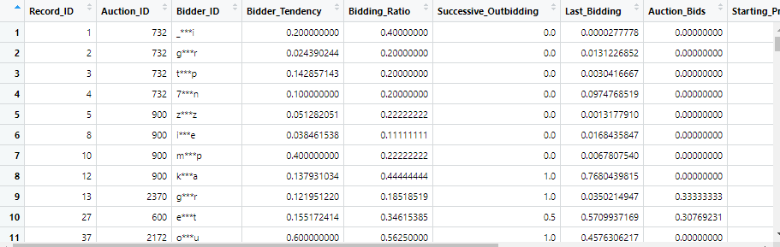
Informasi Kolom
Atribut target untuk klasifikasi adalah Kategori
(donor darah vs. Hepatitis C (termasuk perkembangannya ('hanya' Hepatitis C, Fibrosis, Sirosis).

Slide 5
Metode yang digunakan
Classification adalah tindakan untuk memberikan kelompok pada setiap keadaan. Setiap keadaan berisi sekelompok atribut, salah satunya adalah class attribute. Metode ini butuh untuk menemukan sebuah model yang dapat menjelaskan class attribute itu sebagai fungsi dari input attribute.

Slide 6
Algoritma C5.0
Algoritma C5.0 merupakan salah satu algoritma pohon keputusan yang dapat memproses data kinerja pegawai menjadi sebuah aturan yang bisa dijadikan masukan dalam pengambilan keputusan. Berdasarkan hasil evaluasi terhadap 184 data kinerja pegawai didapat tingkat akurasi sebesar 96.08%.

Slide 7
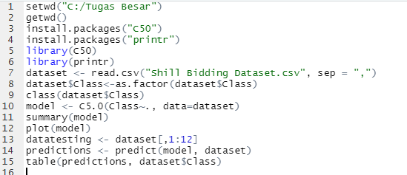
Full Code

Slide 8
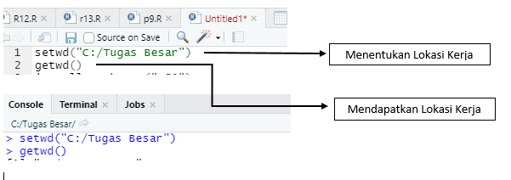
Menentukan Lokasi Kerja

Slide 9
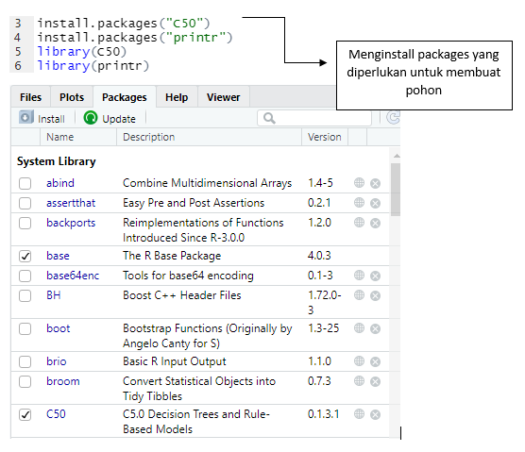
Instalasi Packages

Slide 10
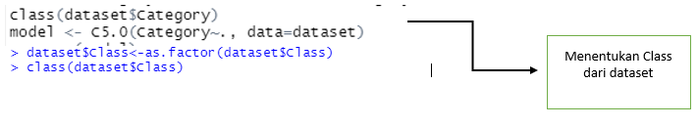
Impor Dataset

Slide 11
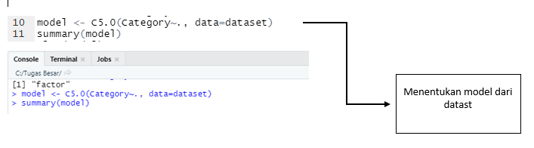
Menentukan Model dari Dataset

Slide 12
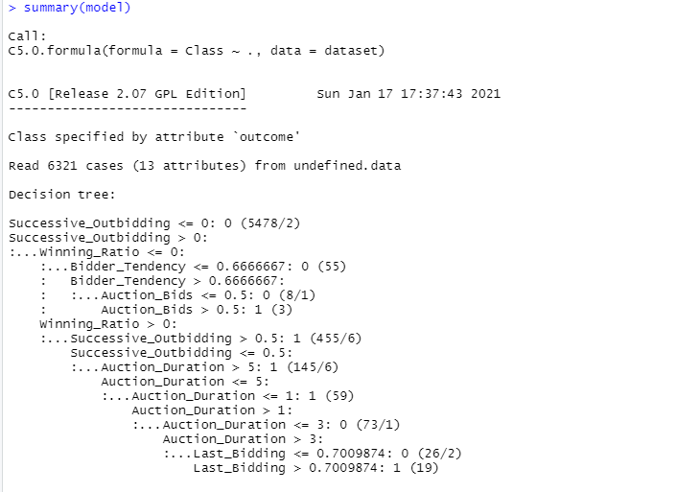
Console

Slide 13
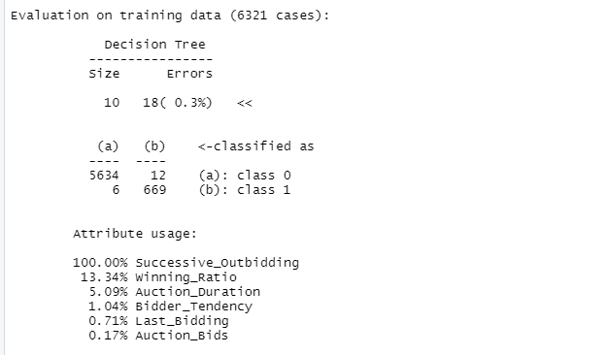
Console

Slide 14
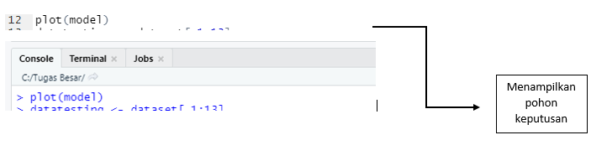
Menampilkan pohon keputusan

Slide 15
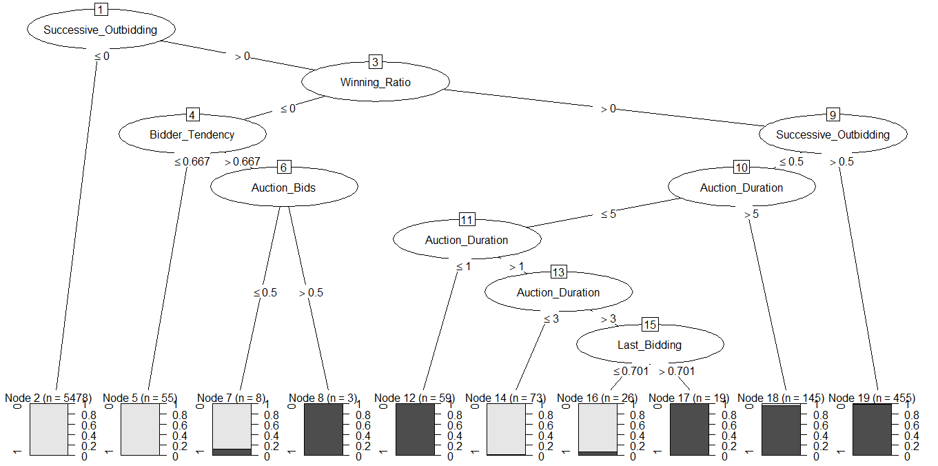
Decision Tree

Slide 16

Meentukan Data Testing
Kode program untuk menentukan Dataset

Slide 17

Menentukan Prediksi
Kode progra, untuk menentukan prediksi

Slide 18


Hasil prediksi Dataset

Slide 19
Repositori Github
https://github.com/crysdy/Tugas-besar-data-mining
Repositori Github Anggota
https://github.com/crysdy
https://github.com/hayilham
https://github.com/kstudylife22

Slide 21
1.
TRANSITION HEADLINE
Let’s start with the first set of slides

